Slide 1
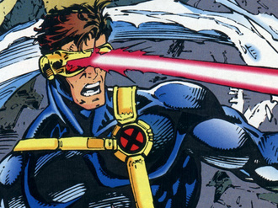
Laser Cat
Presented by:
Almeda Glenn Brandon Tan Troy Toh Lim Wei Heng

Slide 2
Disclaimer
Please note that the pictures provided in this presentation do not intend to infringe any copyright. Credits are given to the sources.
Notes:
Disclaimer to give information that we acknowledge the sources.

Slide 3
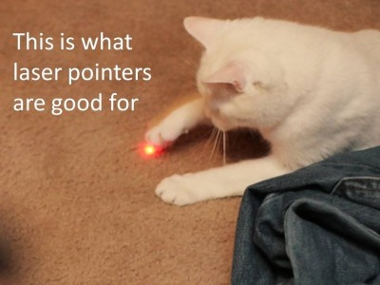
Notes:
Appetizer slides

Slide 4
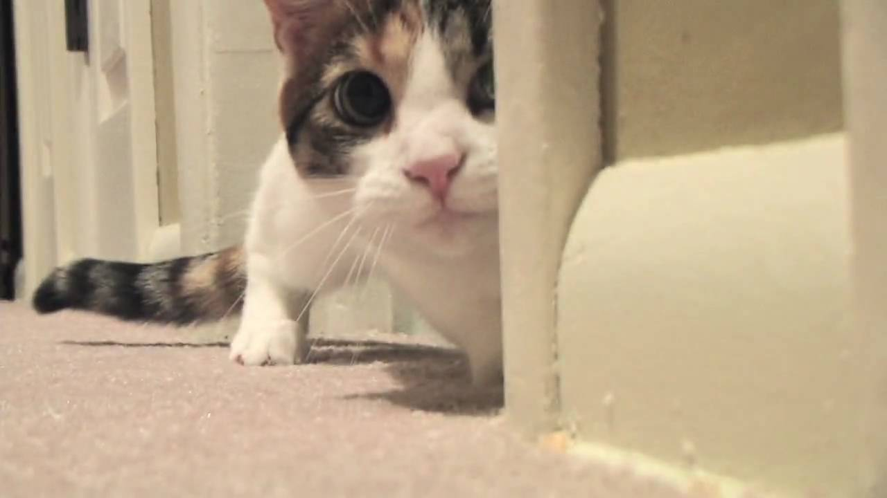
Overview
Our Tasks
Project Schedule
Screenshots (Before & After)
Gameplay Samples
Risks/Concerns
Random Inspirations
Notes:
Who says what must be mentioned here

Slide 5
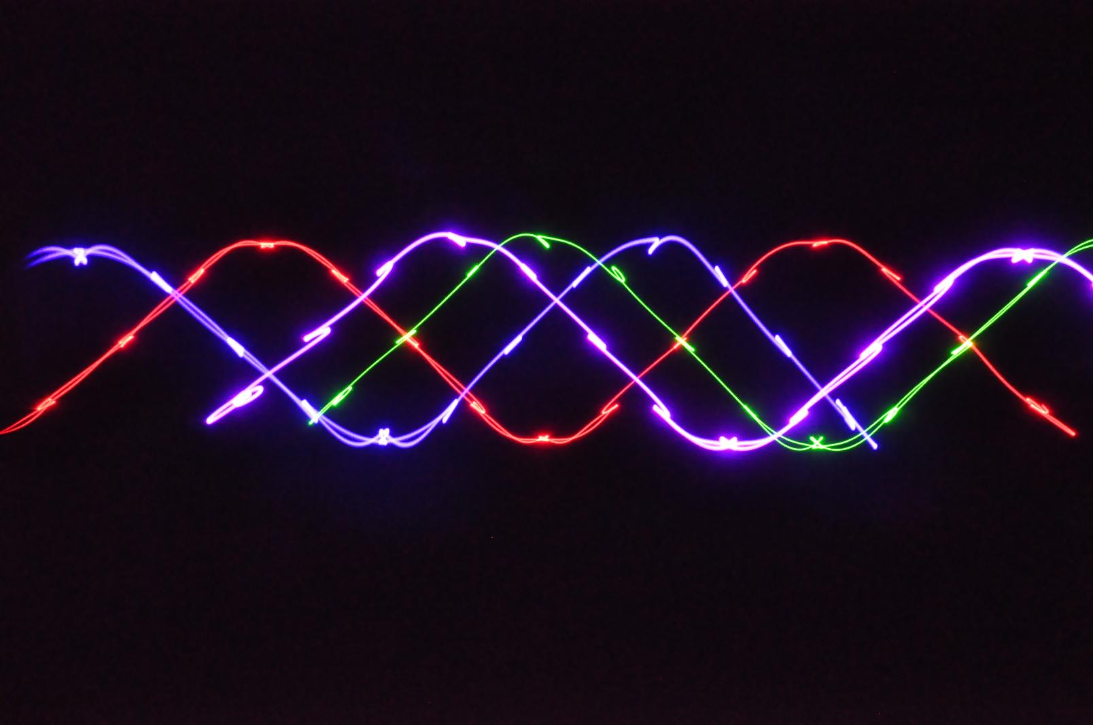
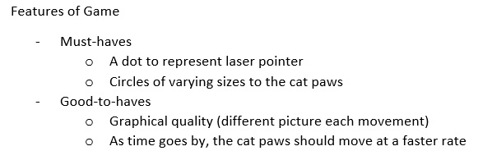
Our Tasks

Slide 6
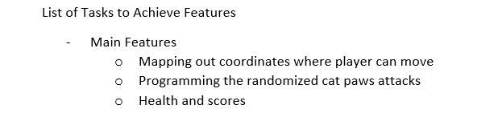
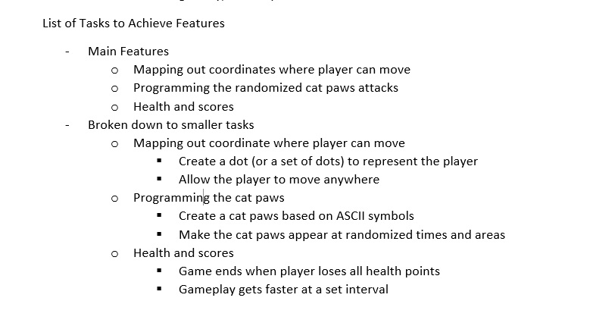
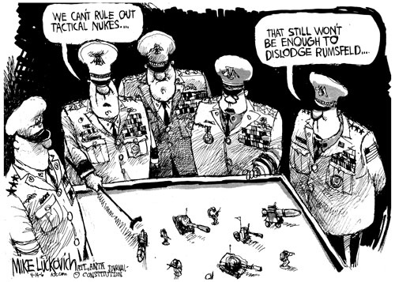
Our Tasks

Slide 7
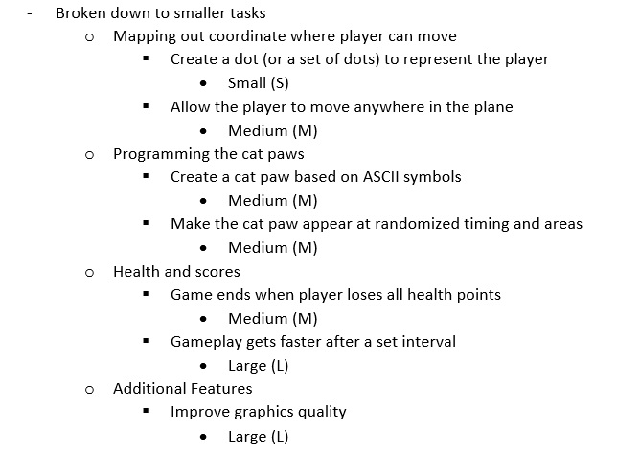
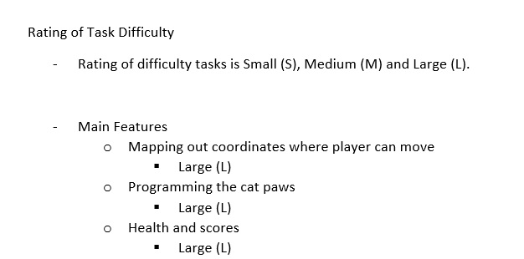
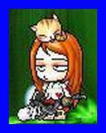
Our Tasks
Notes:
Small < 10 hours, Medium = 10 < x < 20, Large >20 hours

Slide 8

60 hours!!!
Notes:
Minimum number of hours collectively…

Slide 9
So…
Notes:
Add in a picture of your choice (Troy)

Slide 10
Who did what?
Glenn – Documentation Lead/Play-Tester
Troy – Programmer Assist/Documentation Assist
Brandon – Game Programmer Assist
Wei Heng – Game Programmer Lead
Notes:
So who did what?

Slide 11
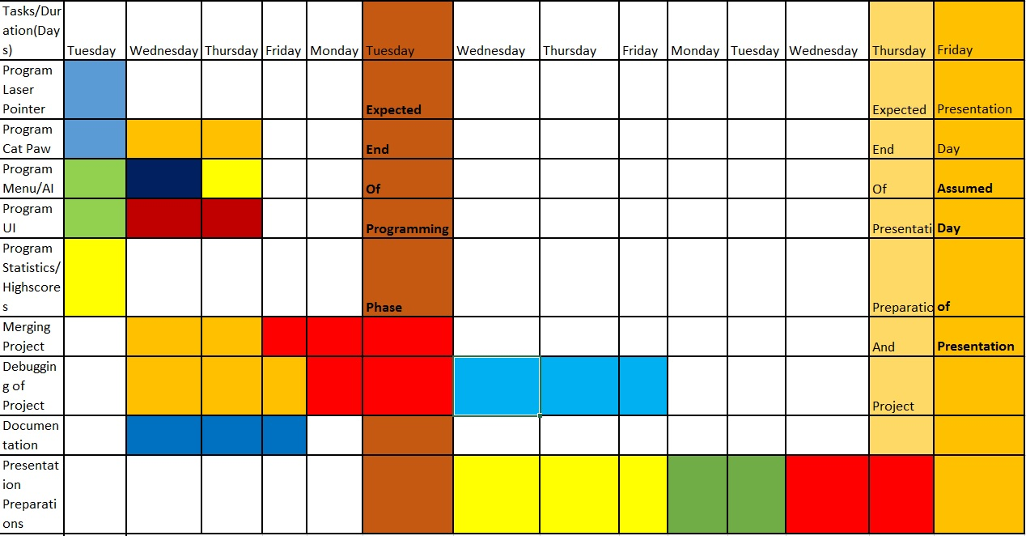
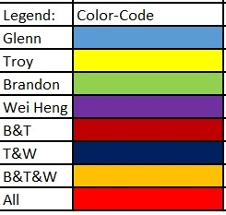
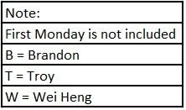
Original Project Schedule
Notes:
Confident that we can finish in two weeks..

Slide 12
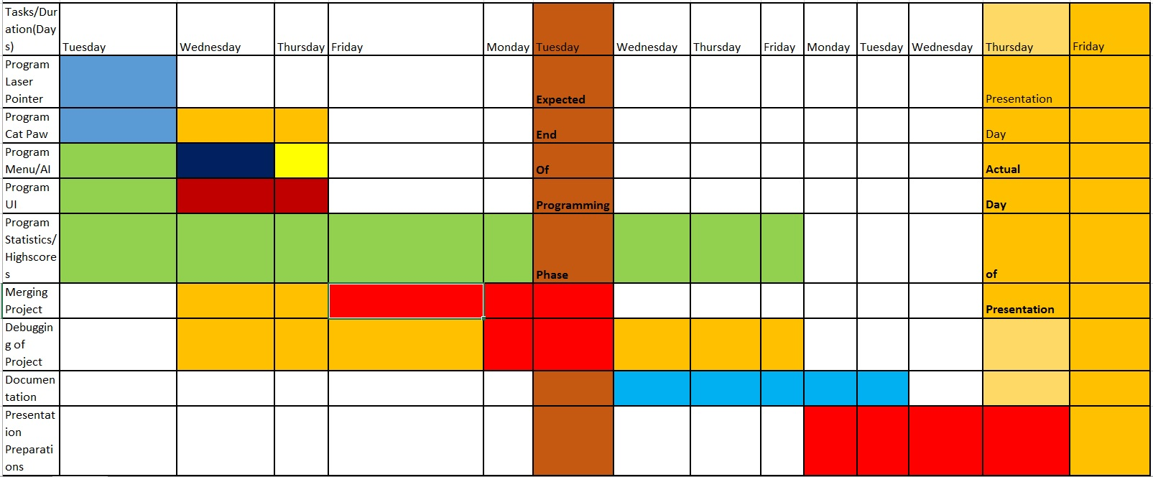
Actual Project Schedule
Notes:
We underestimated a few tasks…lots of optimisation process and highscores problems

Slide 13
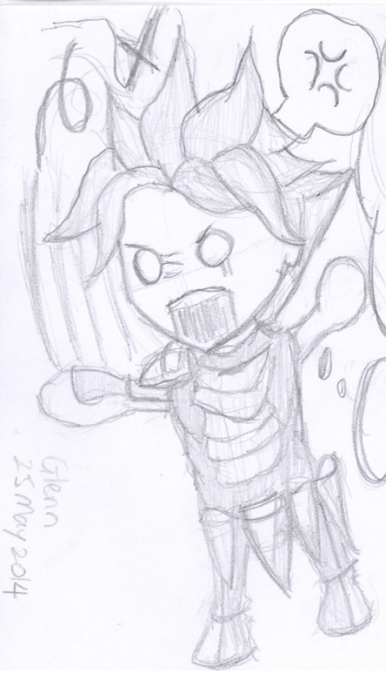
Moving on…
Notes:
Transition cue

Slide 14
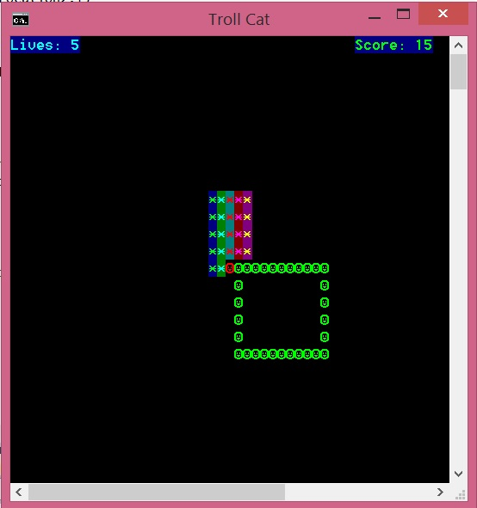
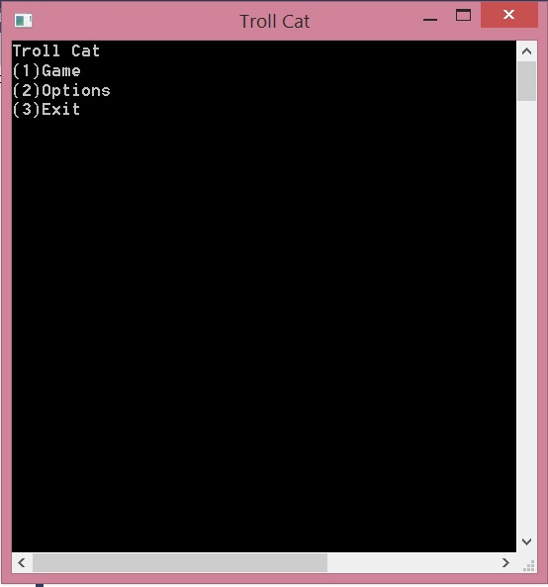
Screenshots (Before)
Initial Menu →
← Initial Gameplay
Notes:
What it looked like when we first started

Slide 15
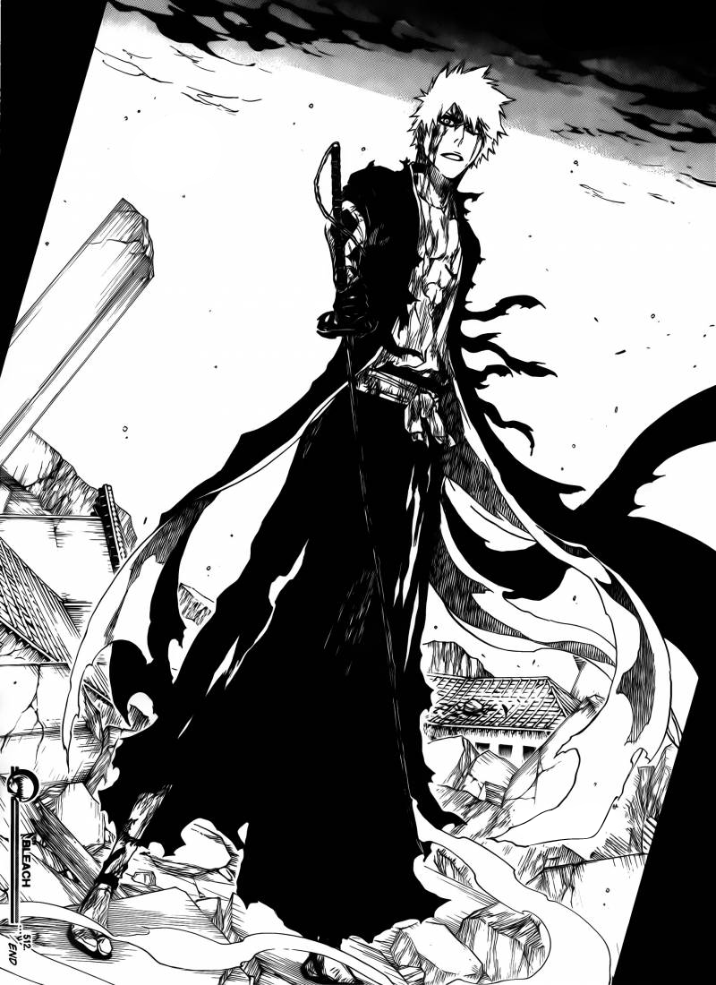
After much work…

Slide 16
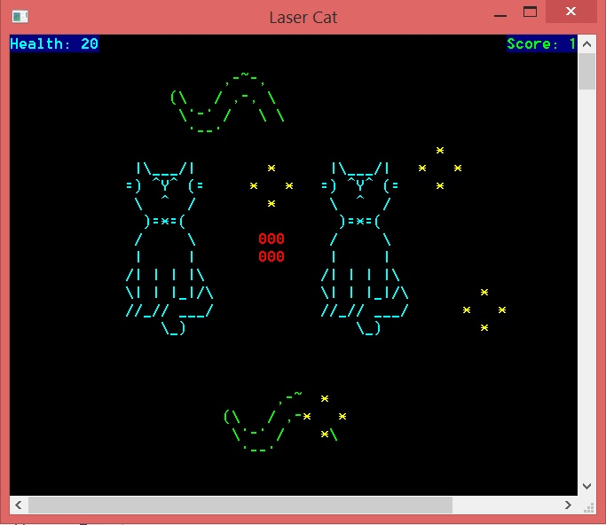
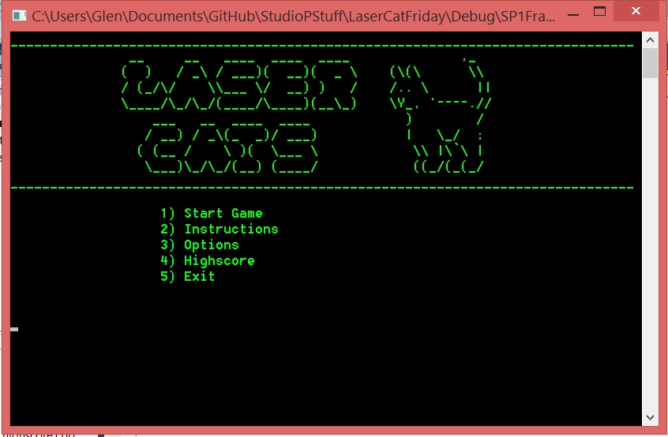
Screenshots (After)
Final Menu →
← Final Gameplay
Notes:
Final outlook

Slide 17
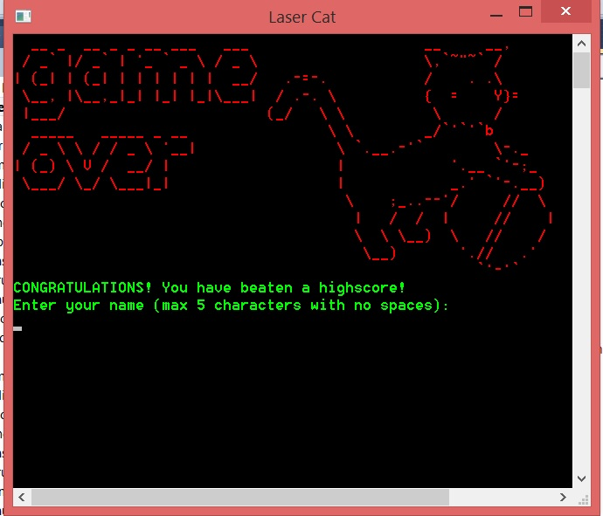
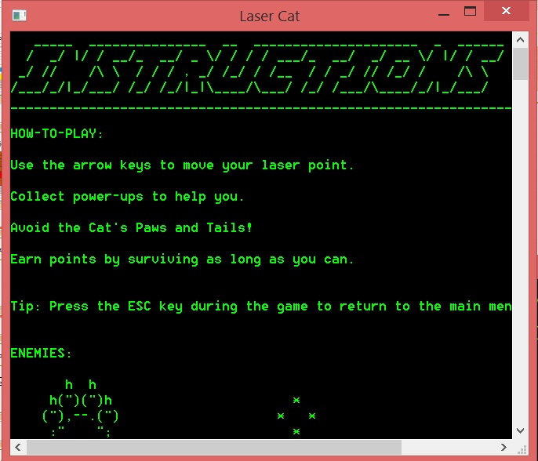
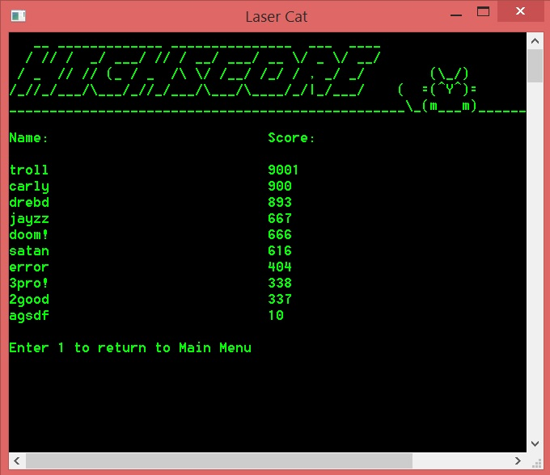
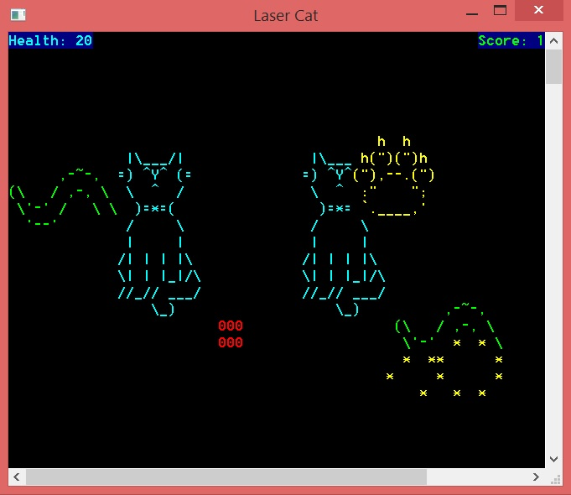
Gameplay Samples
Notes:
Some more samples of our gameplay

Slide 18
But then…
Notes:
Add in a picture of your choice (Brandon)

Slide 19

Risks/Problems/Concerns
Perceived lack of reflexes
Unseen bugs in the gameplay
Notes:
Points that we considered during the project

Slide 20
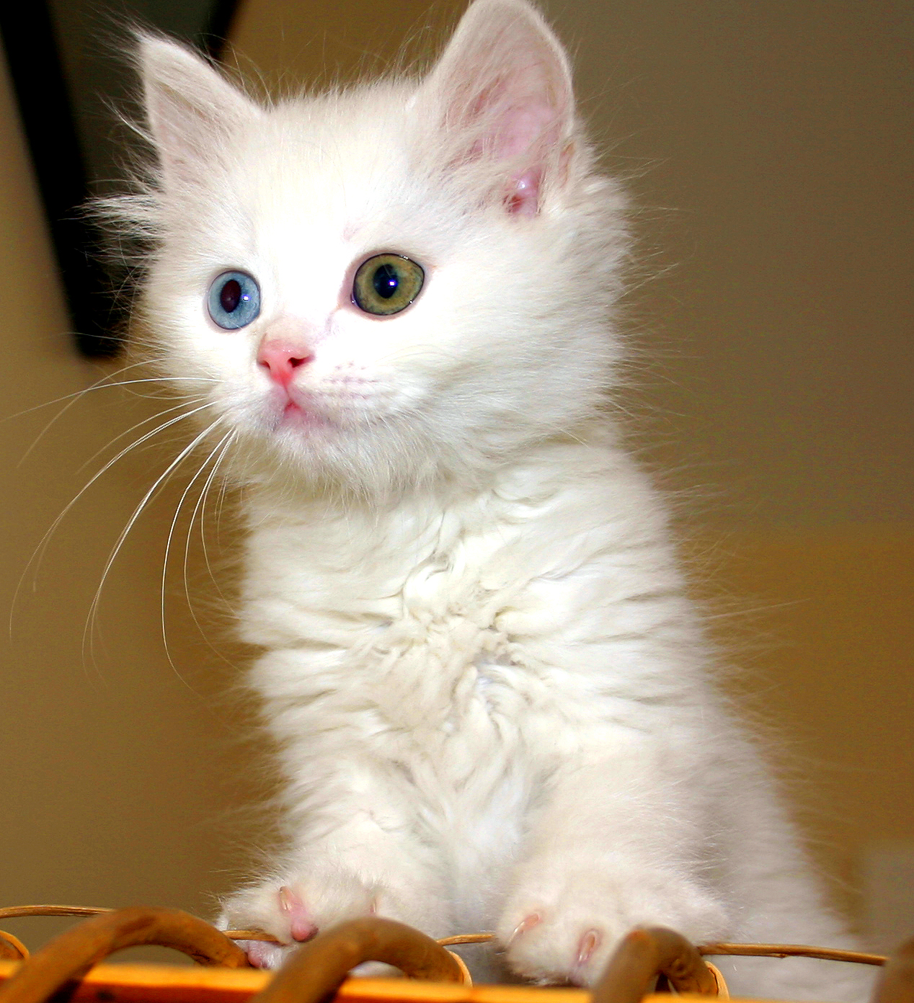
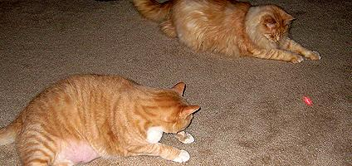
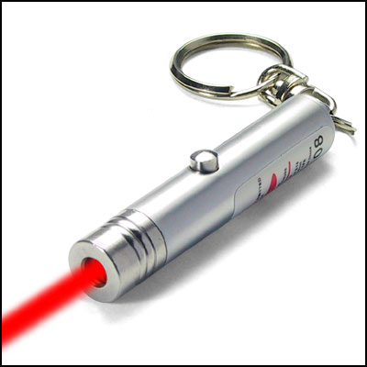
Inspirations
Notes:
Where we got our inspirations from

Slide 21
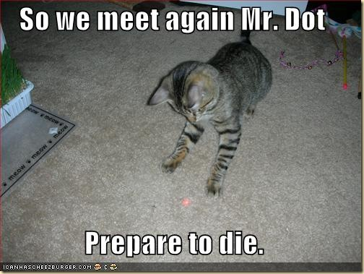

Slide 22
Thank You!!

